Slide 1



SIEMENS
Marine Workflow
Siemens Industry Software (India) Private Limited

Slide 2


Agenda
Agenda
Introduction | 3
Brief Insights about Our Data | 5
Proposed Webpage Overview | 6
Area of Improvements | 7
Advantages of the New Analytical Webpage | 11

Slide 3
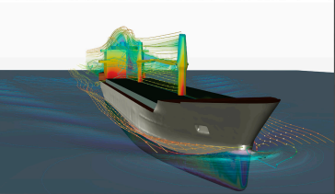
Introduction
Siemens DISW is engaged in diverse projects.
This presentation focuses on our marine project.
Discussion will cover the analytical webpage developed for the project to analyzes various states:
Memory usage
Assembly states
Timer states
Network states

Slide 4
Disclaimer
All the data is made up just to create the plots and visualizations for our webpage. It is not real data.

Slide 5
Meta Data
JSON Data
Environment
Step Details
Brief Insights about our Data
StepID
Memory State
Assembly State
Timer State
Network State
Number of Fully Loaded Parts
Number of Partially Loaded Parts
Number of Minimally Loaded Parts
NumSoaCalls
NumPdiCalls
NumFccCalls
Bytes per Object
Bytes in use
Max bytes in use
Bytes from OS
Bytes for Rollback in use
OS Bytes for Rollback
Time required to perform operation

Slide 6

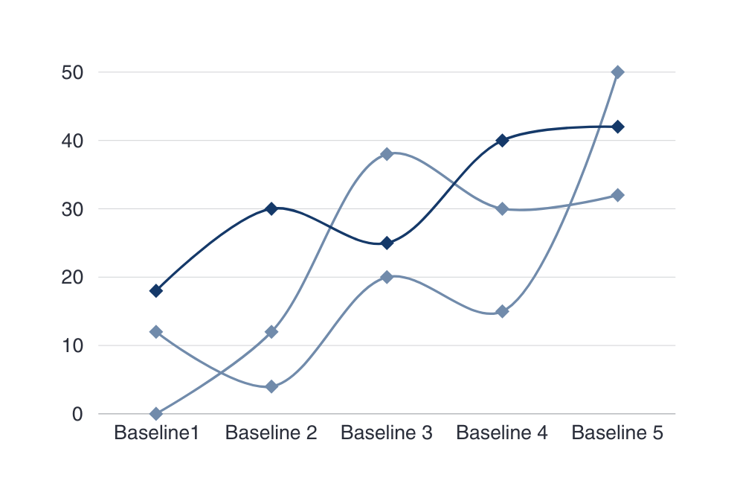
Proposed Webpage Overview
TOOL UTILIZED FOR ANALYSIS
Python (Pandas)
ANALYSIS PERFORMED
Testwise Baseline Analysis
Statewise Baseline Analysis
Stepwise Baseline Analysis
Detailed Analysis of Baseline
TOOL UTILIZED FOR WEBPAGE
Flask

Slide 7
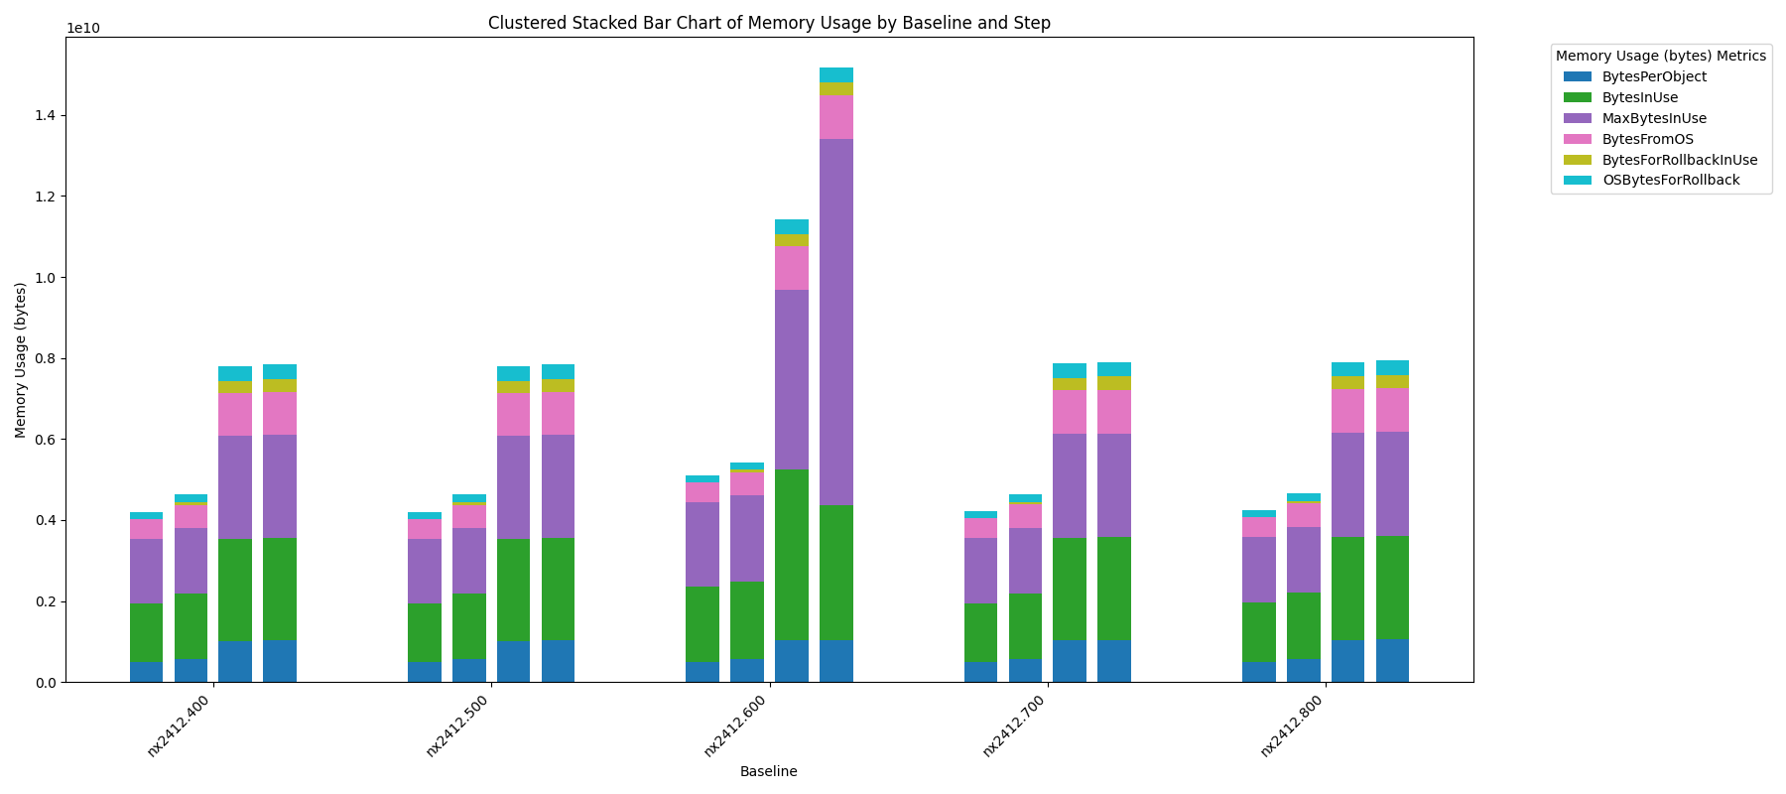
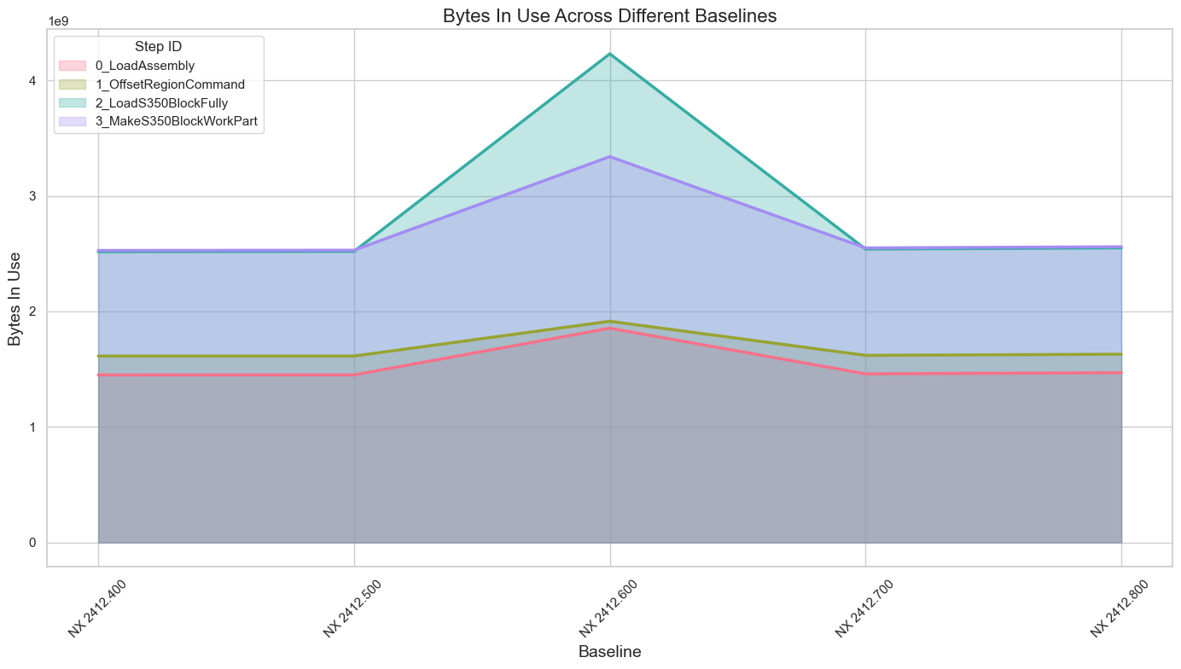
Area of Improvements
Clustered Stack Bar Plot
Area Map

Slide 8
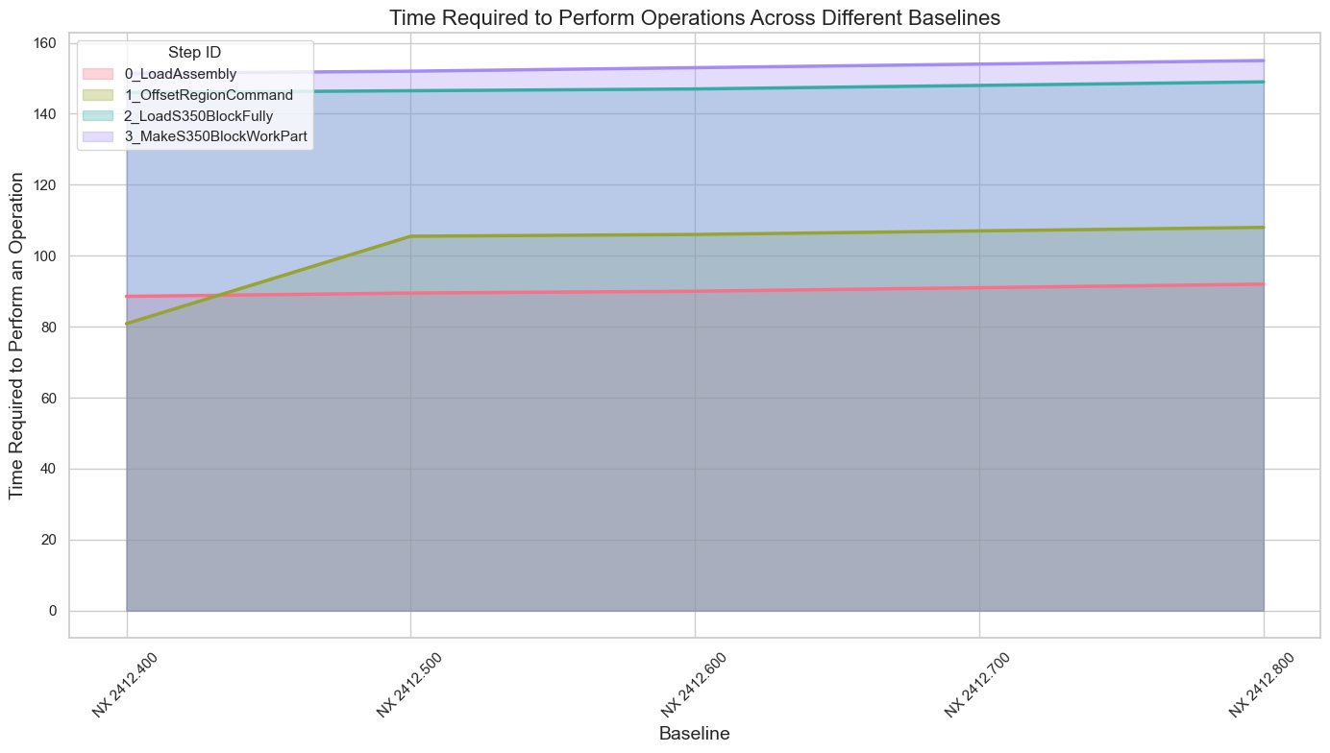
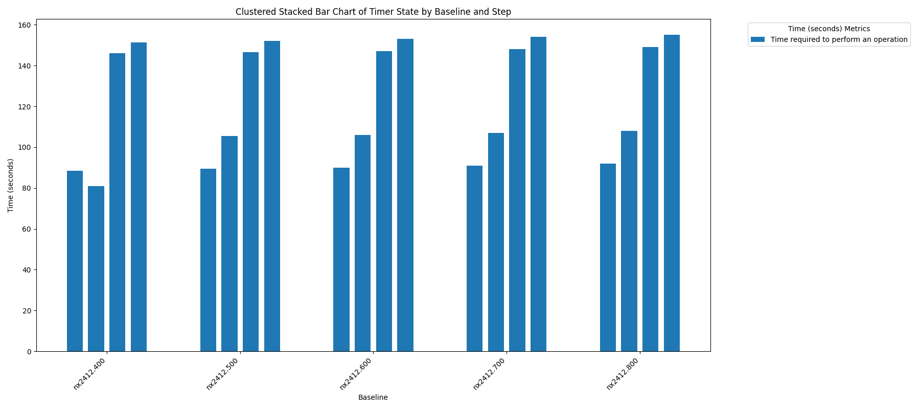
Area of Improvements
Clustered Stack Bar Plot
Area Map

Slide 9
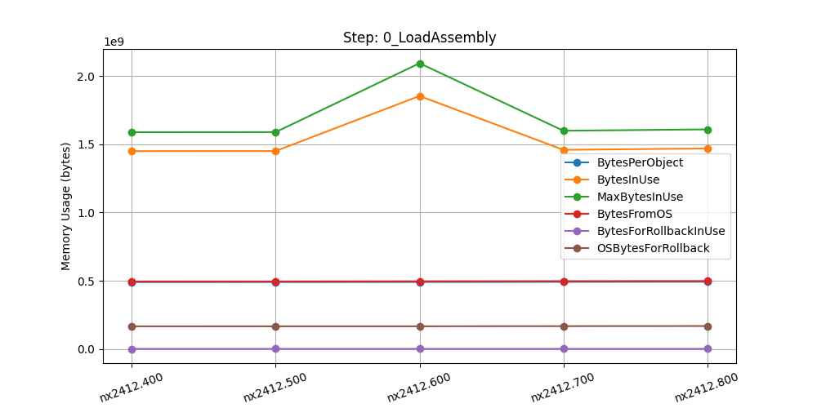
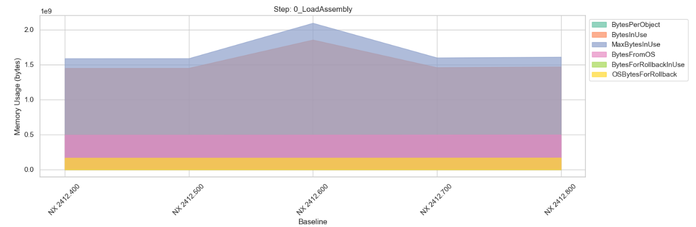
Area of Improvements
Line Chart
Area Map

Slide 10
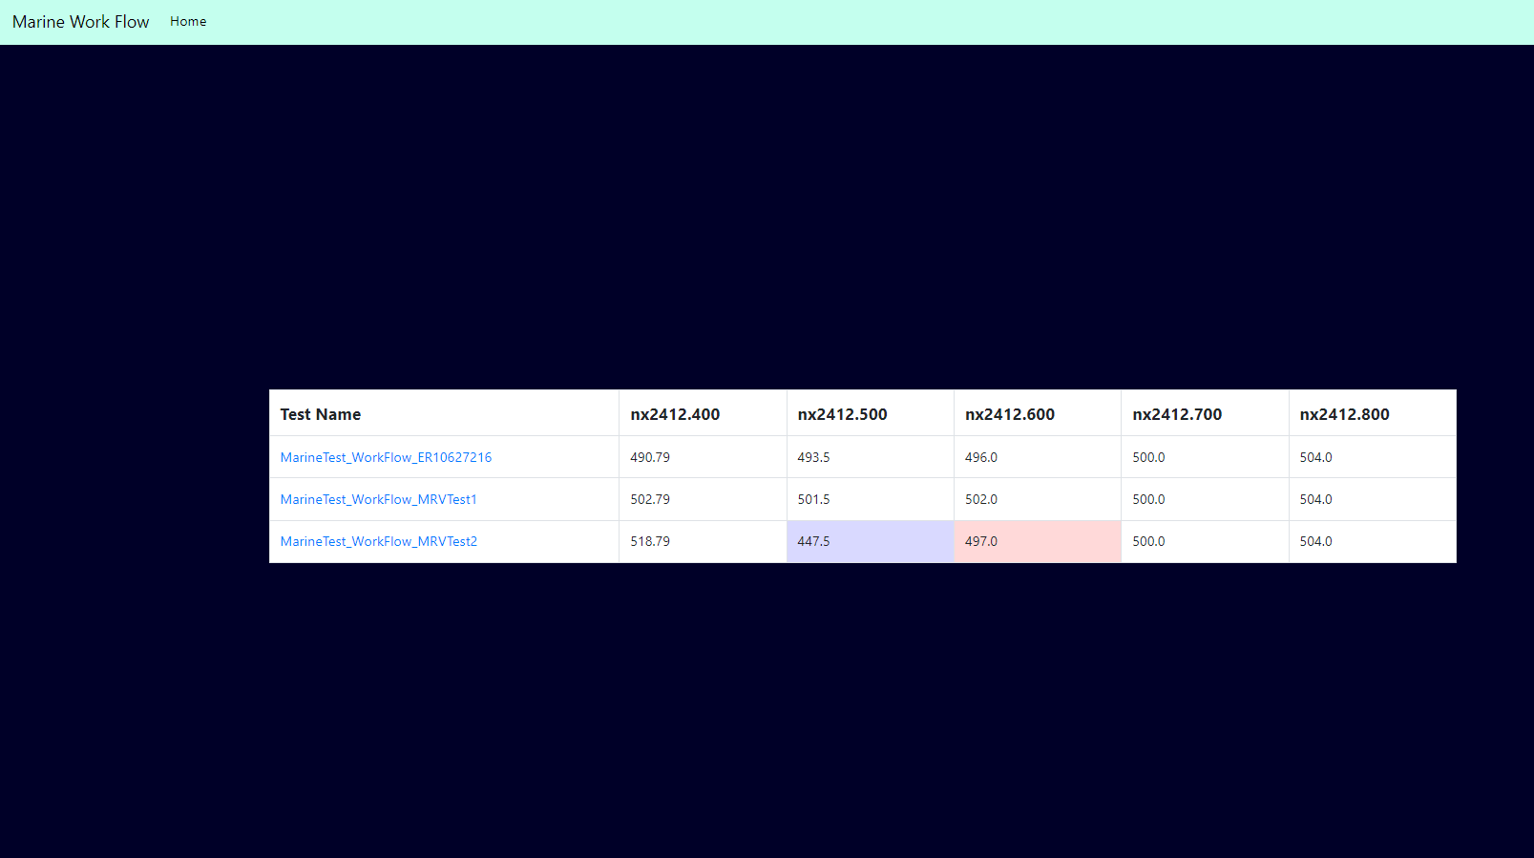
Area of Improvements

Slide 11


Advantage of Proposed Analytical Webpage
Easy to Perform Analysis Using Python
Flexibility and Ease of Code Modification
Visual Data Insights
Large Python Community

Slide 12
Thankyou

